Slide 1
LAN Switching
Master Nguyen Huu Trung
Faculty Of Information Technology
HCMC University of Technology and Education

Slide 2
Contents
Understanding the challenges with Switched LAN Technology
Exploring the packet Delivery Process 1 (layer 1)
Exploring the packet Delivery Process 2 (layer 2)
Exploring the packet Delivery Process 3 (layer 3)

Slide 3
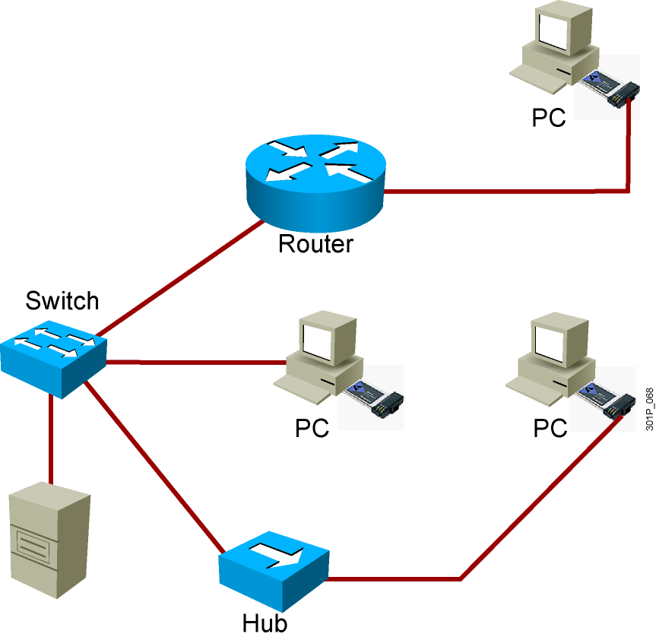
LAN Components & Functions of a LAN
Computers
PCs
Servers
Interconnections
NICs
Media
Network devices
Hubs
Switches
Routers
Protocols
Ethernet
IP
ARP
DHCP
==============
Data and applications
Share resources
Provide communication path to other networks

Slide 4
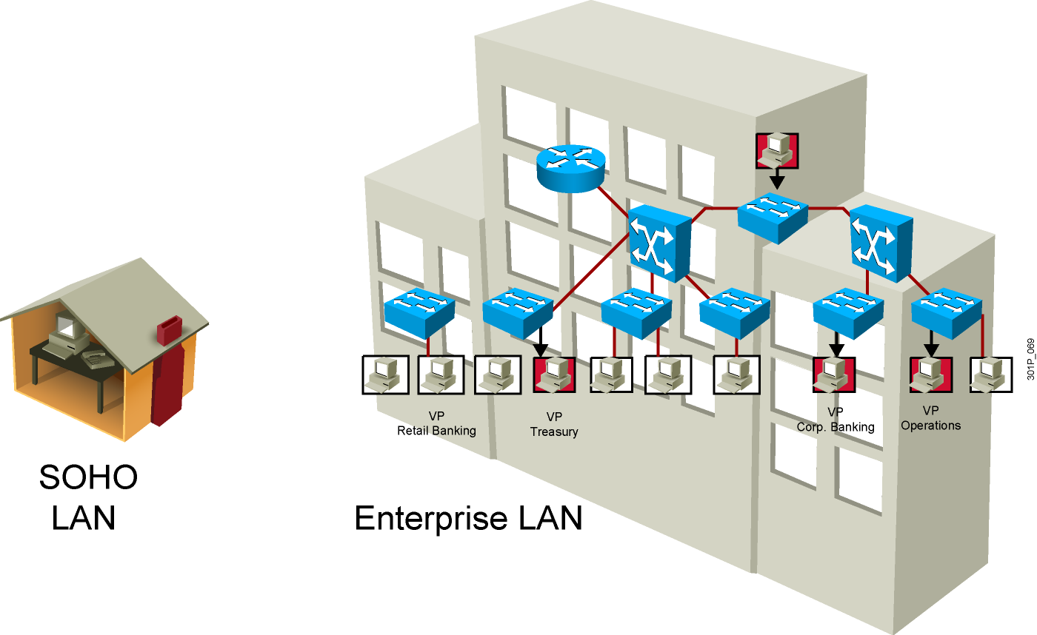
LAN Sizes

Slide 5
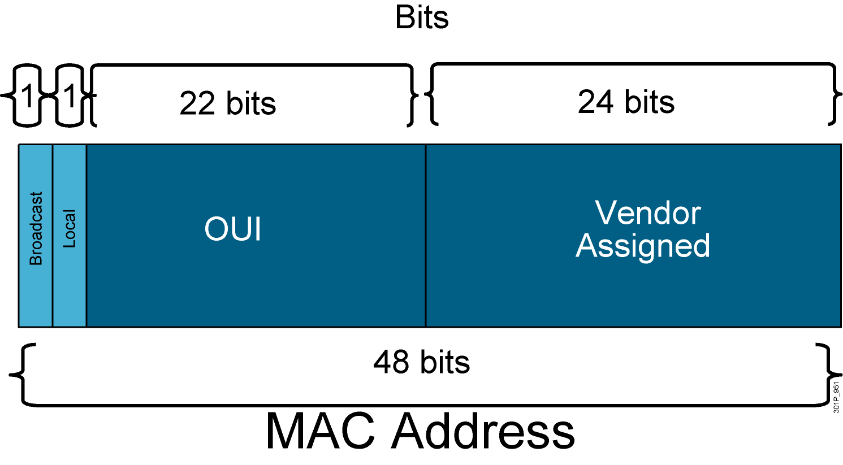
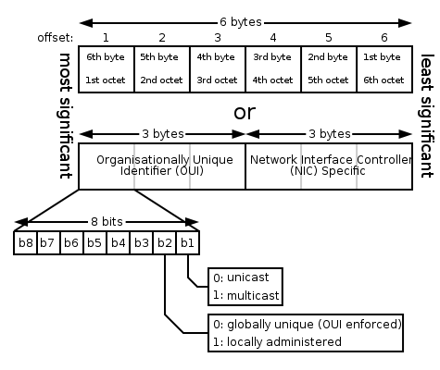
MAC Address Components
Organizationally Unique Identifier
Notes:
Các địa chỉ MAC có chiều dài 6 bytes, thường bao gồm 3 loại:
+ Unicast: Bit I/G là bit có trọng số lớn nhất trong octet có trọng số lớn nhất được gán bằng 0
+ Broadcast: Là một địa chỉ tượng trưng cho tất cả các thiết bị trong mạng LAN segment ở một thờI điểm. Địa chỉ này có dạng 0xFFFF.FFFF.FFFF.
+ Multicast: Bit I/G được gán bằng 1.
Có 04 cách xem MAC
ipconfig /all
Dùng MAC Address Changer 6.0
=> Properties => Advanced
HKEY_LOCAL_MACHINESYSTEMCurrentControlSetControlClass{4D36E972-E325-11CE-BFC1-08002BE10318}

Slide 6
I. Understanding the challenges with Switched LAN Technology

Slide 7
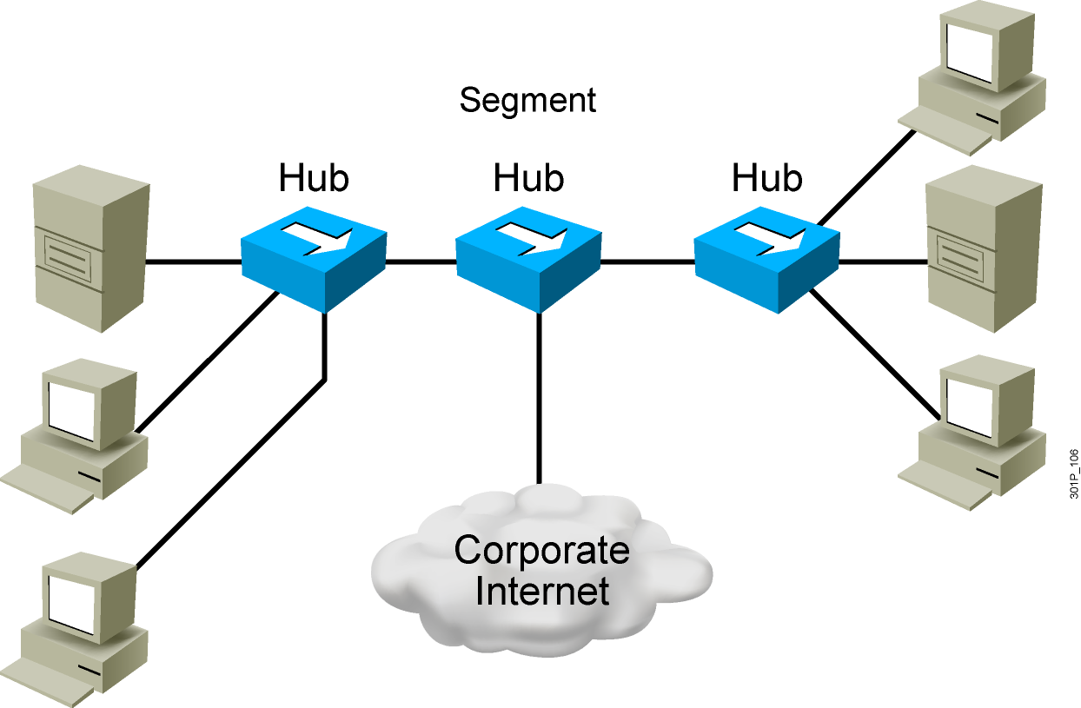
Network Congestion
High-performance PCs
More networked data
Bandwidth-intensive applications
Notes:
tắc nghẽn mạng Máy tính hiệu suất cao Nối mạng dữ liệu Các ứng dụng băng thông rộng

Slide 8
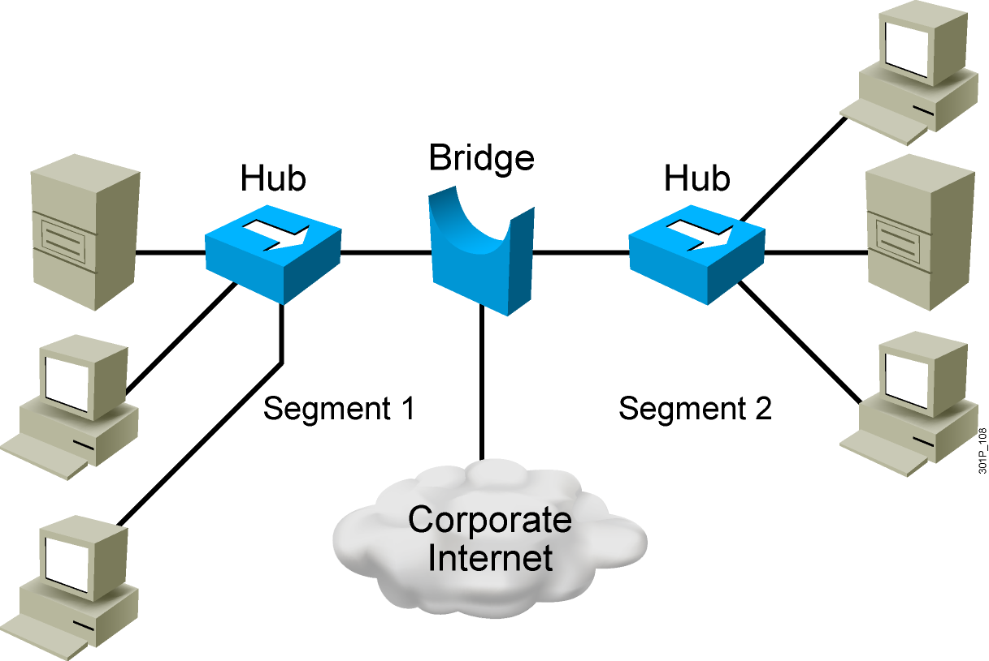
Bridges
Operate at Layer 2 of the OSI model
Forward, filter, or flood frames
Have few ports
Are slow
Notes:
Hoạt động ở lớp 2 của mô hình OSI Về phía trước, bộ lọc, hoặc lũ lụt khung Có vài cổng chậm

Slide 9
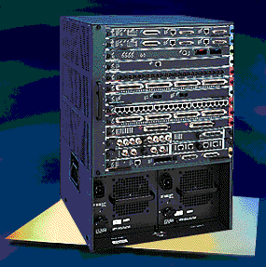
LAN Switch
High port density
Large frame buffers
Mixture of port speeds
Fast internal switching
Switching modes:
Cut-through
Store-and-forward
Fragment-free
Notes:
Mật độ cổng cao Bộ đệm khung hình lớn Hỗn hợp của tốc độ cổng Chuyển mạch nội bộ nhanh chóng Chuyển đổi chế độ: Cắt giảm - thông qua Lưu trữ và chuyển tiếp Phân mảnh - miễn phí

Slide 10
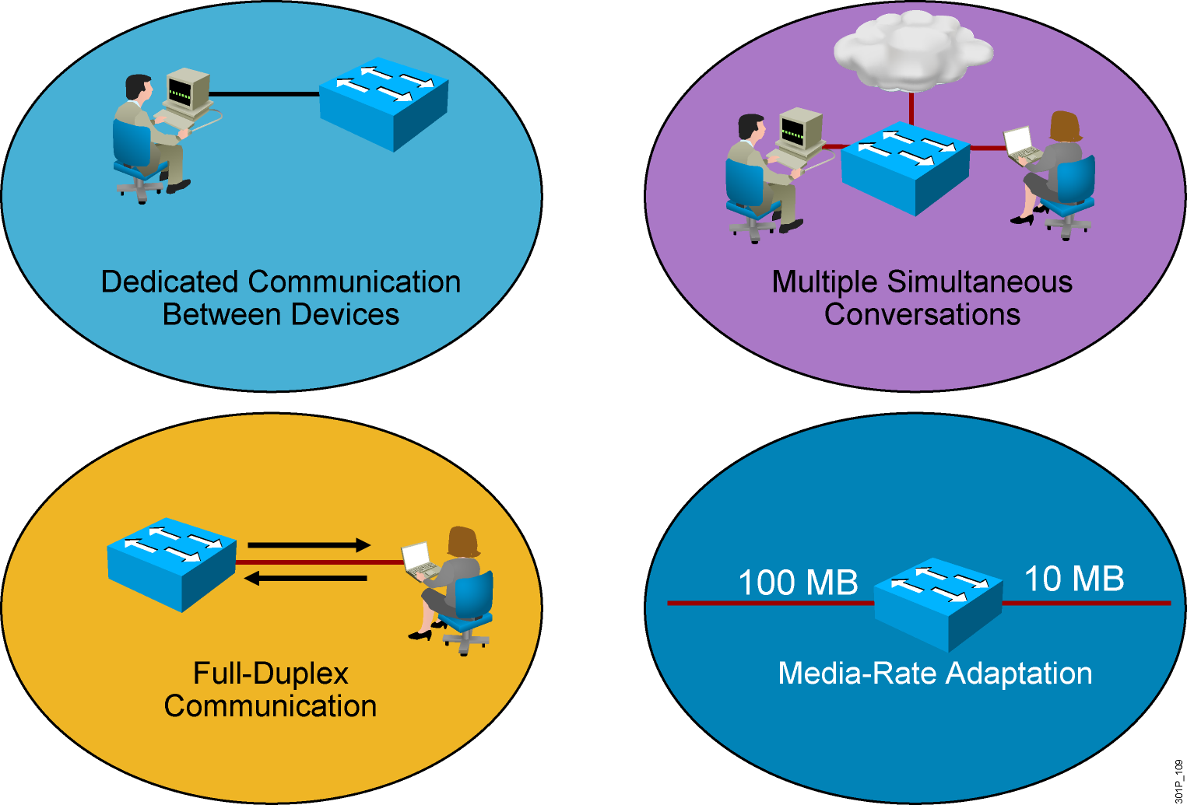
LAN Switch Features
Notes:
Dedicated: chuyên dụng

Slide 11
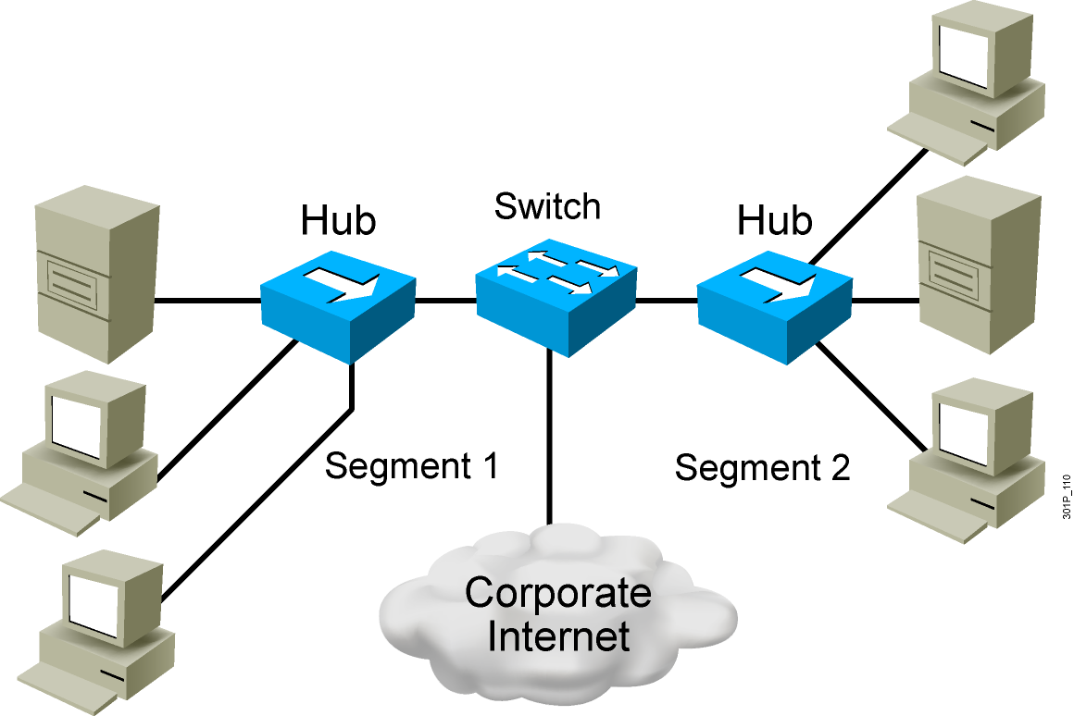
Switches Supersede Bridges
Operate at Layer 2 of the OSI model
Forward, filter, or flood frames
Have many ports
Are fast

Slide 12
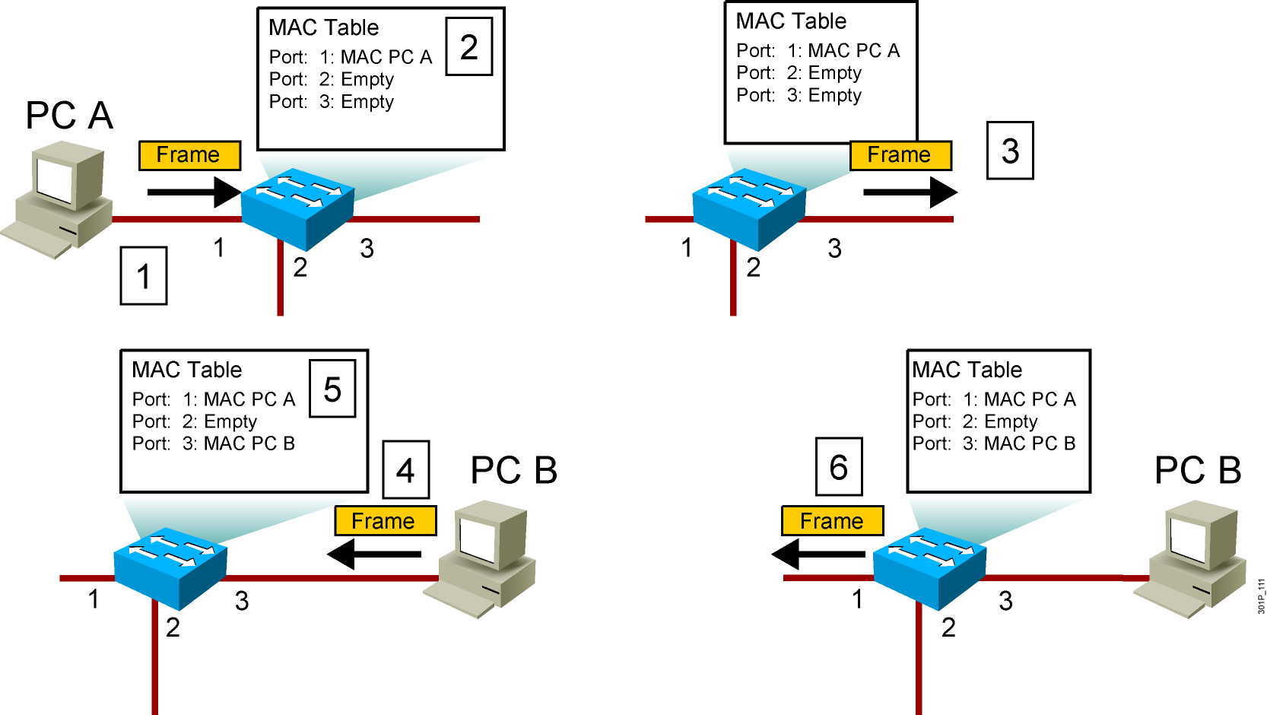
Switching Frames
Notes:
Lesson Aim
<Enter lesson aim here.>

Slide 13
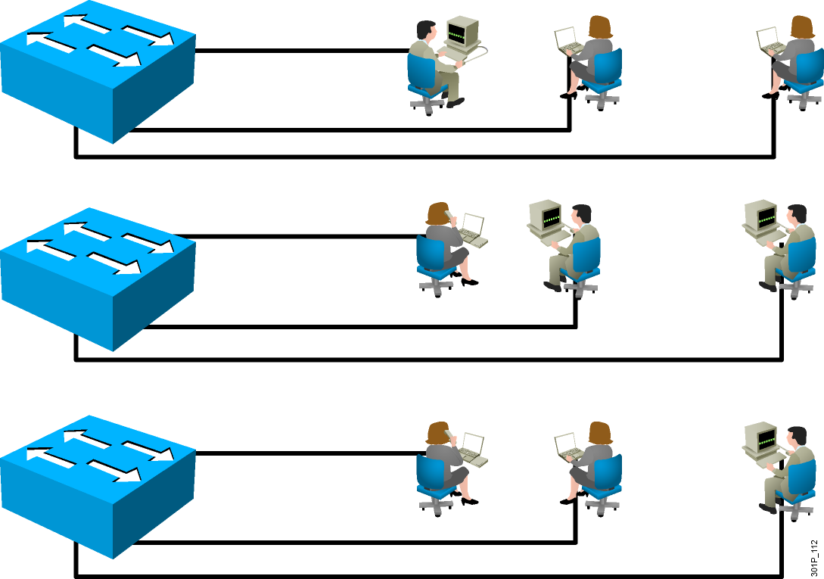
LANs Today
Users grouped by physical location
More switches added to networks
Switches connected by high-speed links

Slide 14
II. Exploring the packet Delivery Process 1 (layer 1)

Slide 15
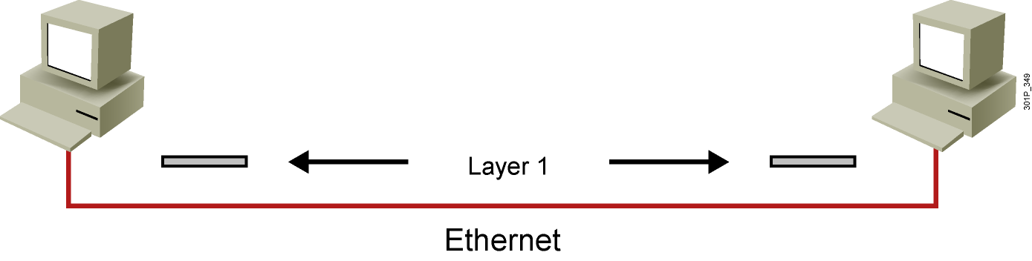
Layer 1 Devices
Layer 1 provides the physical media and its encoding.
Examples:
Ethernet
Serial
Repeater
Physical interface of the NIC
Notes:
Lesson Aim
<Enter lesson aim here.>

Slide 16
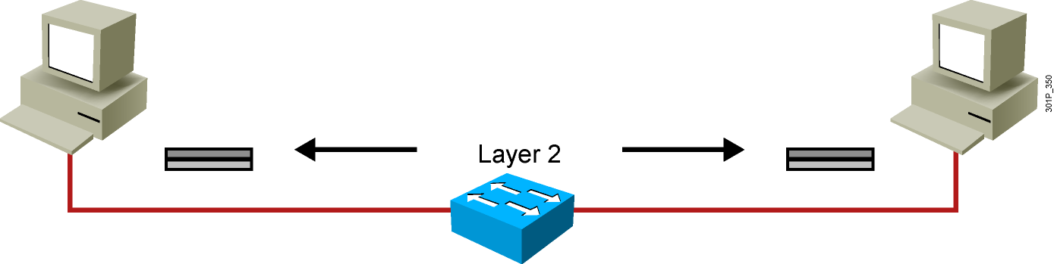
Layer 2 Devices
Layer 2 devices provide an interface with the physical media.
Examples:
NIC
Bridge
Switch
Notes:
Lesson Aim
<Enter lesson aim here.>

Slide 17
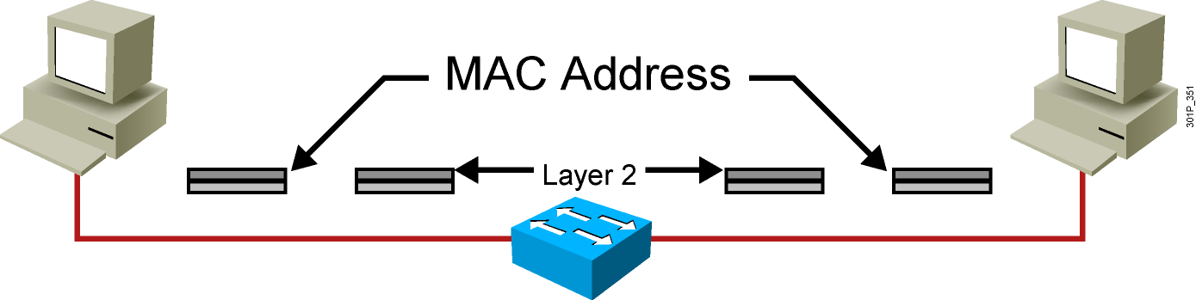
Layer 2 Addressing
MAC address
Assigned to end devices
Notes:
Lesson Aim
<Enter lesson aim here.>

Slide 18
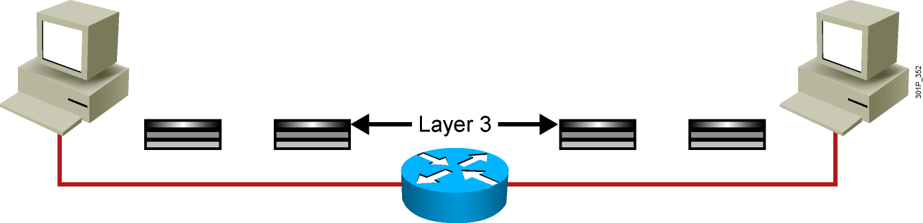
Layer 3 Devices and Their Function
The network layer provides connectivity and path selection between two host systems.
In the host, this is the path between the data link layer and the upper layers of the Network Operating System(NOS).
In the router, it is the actual path across the network.
Notes:
Layer 3 thiết bị và chức năng của chúng Tầng mạng cung cấp kết nối và lựa chọn con đường giữa hai hệ thống máy chủ. Trong máy chủ, đây là con đường giữa các lớp liên kết dữ liệu và các tầng trên của NOS. Trong router, nó là con đường thực tế trên mạng.

Slide 19
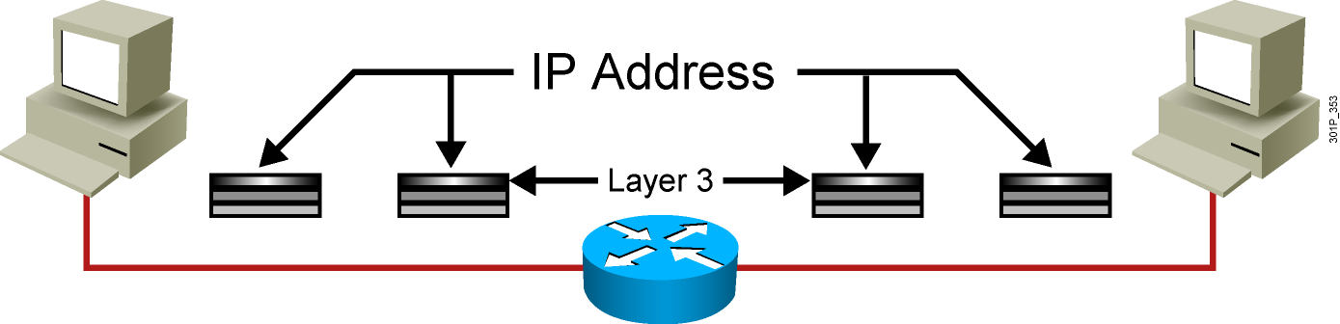
Layer 3 Addressing
Each NOS has its own Layer 3 address format.
OSI uses an Network Service Access Point.
TCP/IP uses IP.
Notes:
Lesson Aim
<Enter lesson aim here.>

Slide 20
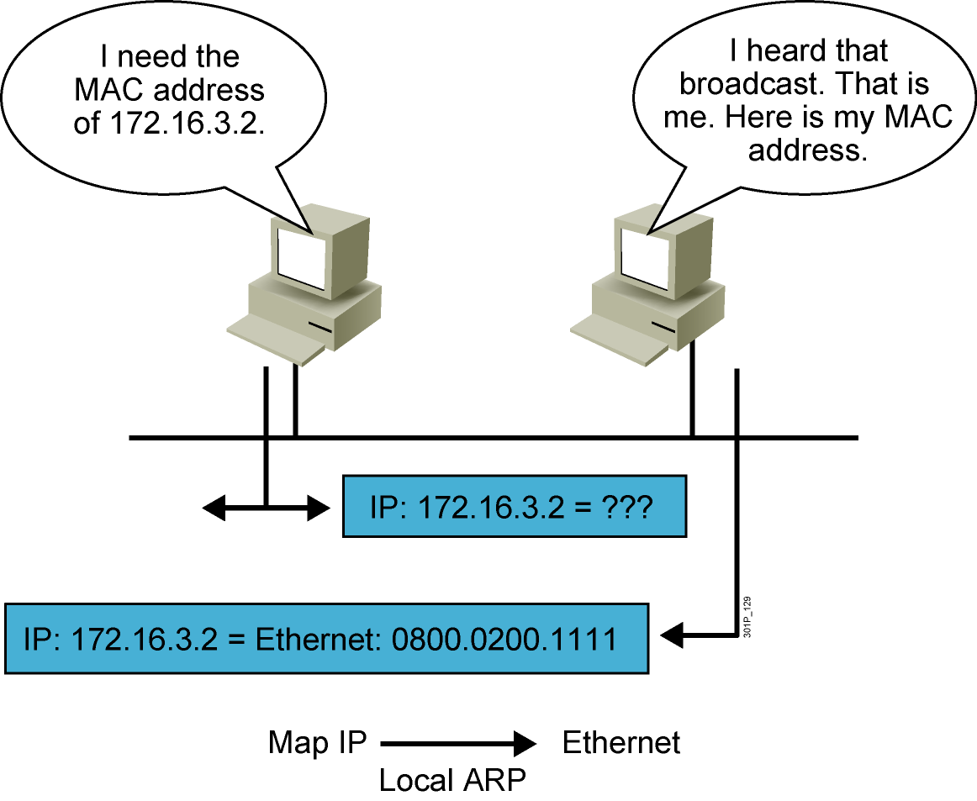
ARP
Notes:
Lesson Aim
<Enter lesson aim here.>

Slide 21
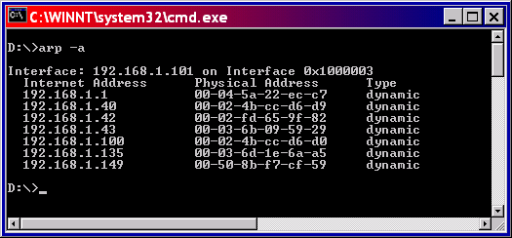
ARP Table

Slide 22
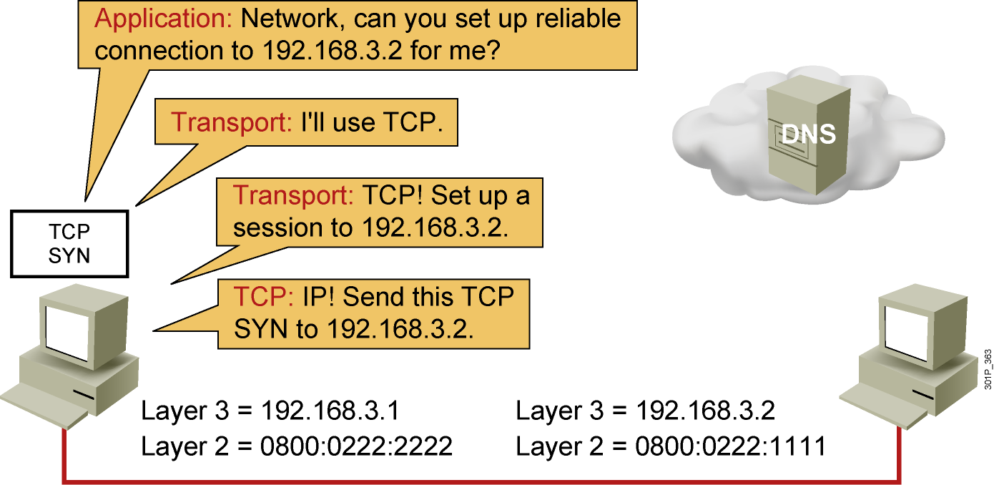
Host-to-Host Packet Delivery (1 of 22)
Notes:
Lesson Aim
<Enter lesson aim here.>

Slide 23
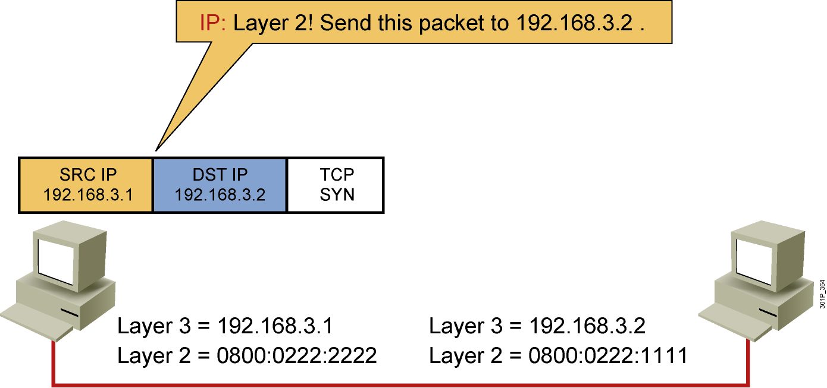
Host-to-Host Packet Delivery (2 of 22)
Notes:
Lesson Aim
<Enter lesson aim here.>

Slide 24
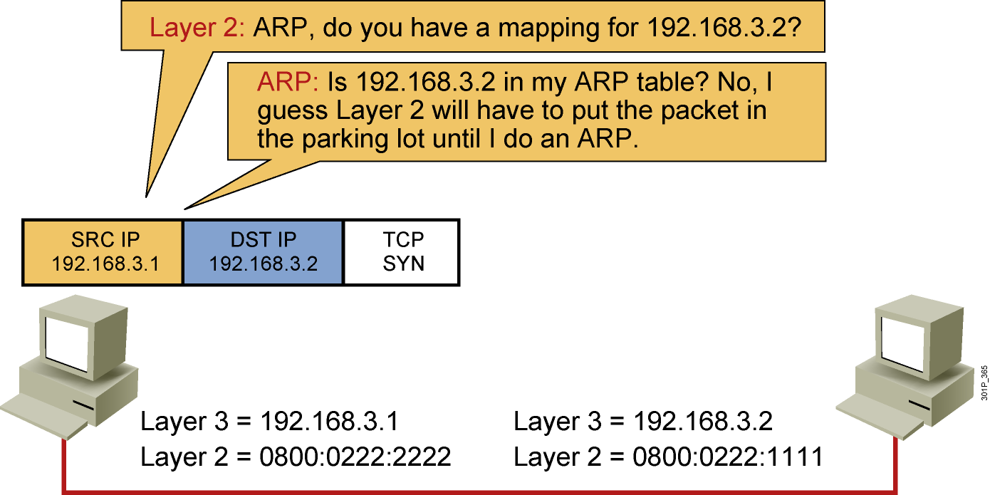
Host-to-Host Packet Delivery (3 of 22)
Notes:
Lesson Aim
<Enter lesson aim here.>

Slide 25
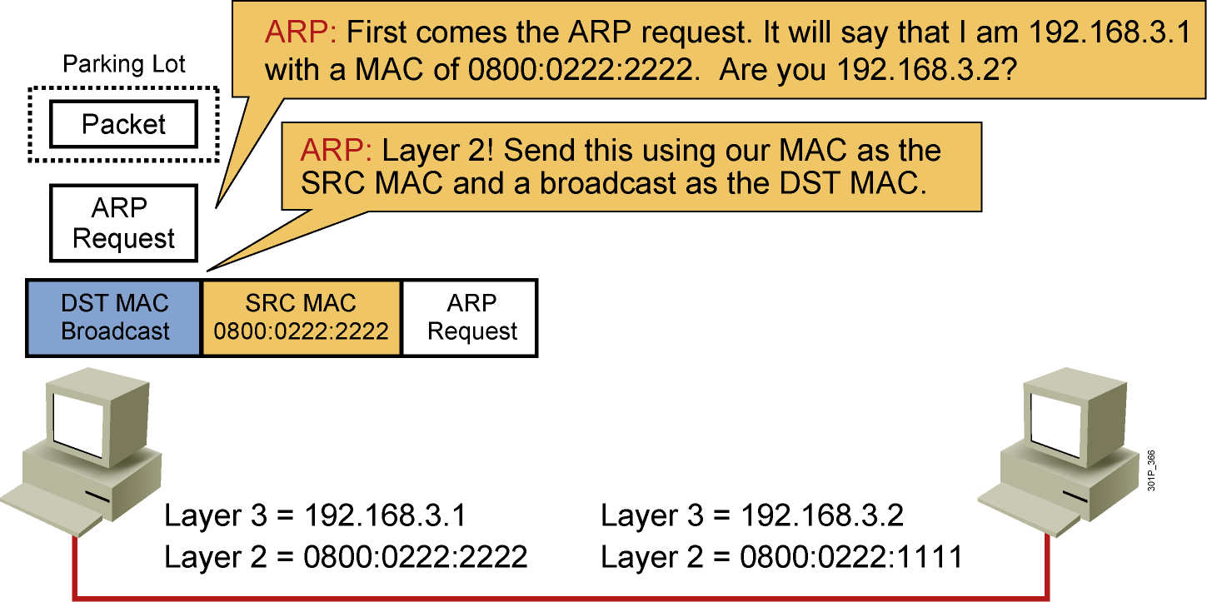
Host-to-Host Packet Delivery (4 of 22)
Notes:
Lesson Aim
<Enter lesson aim here.>

Slide 26
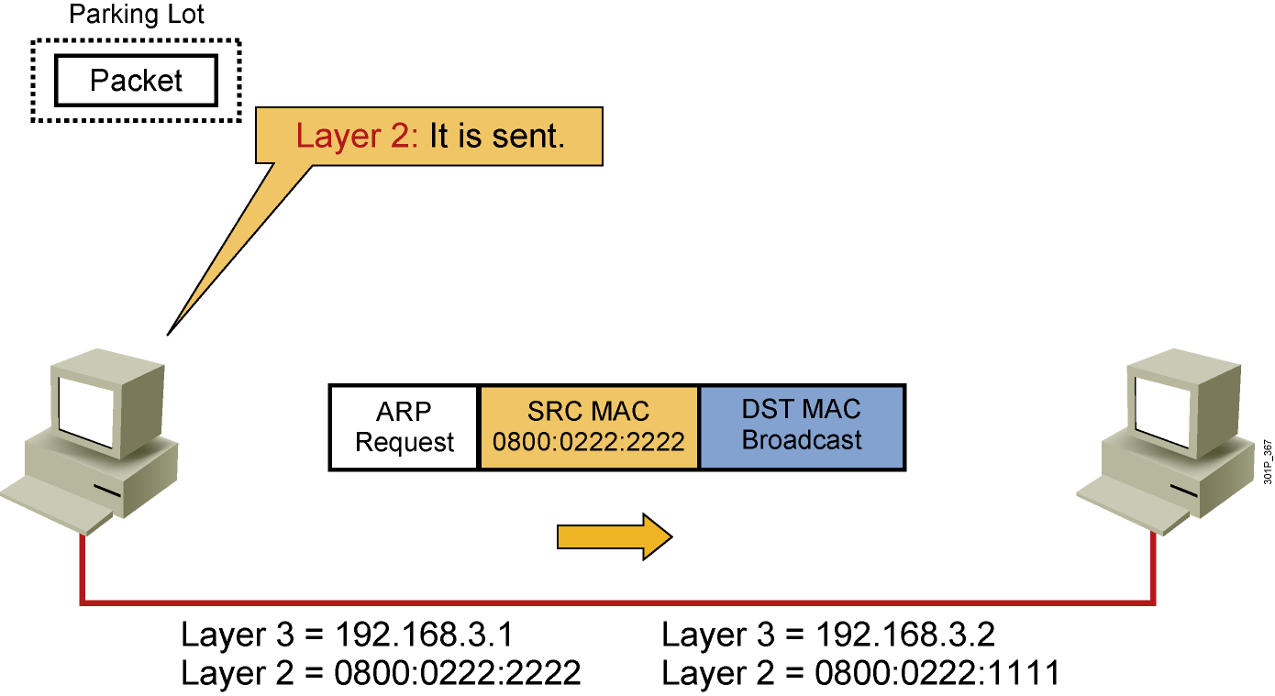
Host-to-Host Packet Delivery (5 of 22)
Notes:
Lesson Aim
<Enter lesson aim here.>

Slide 27
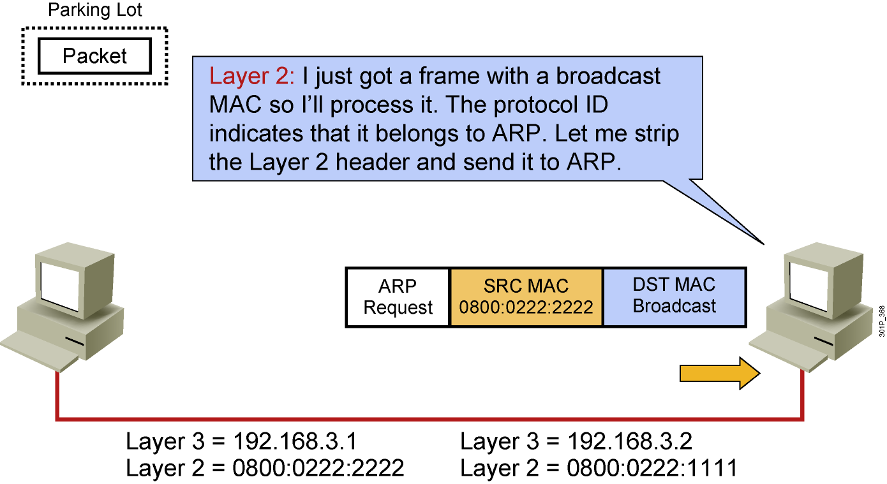
Host-to-Host Packet Delivery (6 of 22)
Notes:
Lesson Aim
<Enter lesson aim here.>

Slide 28
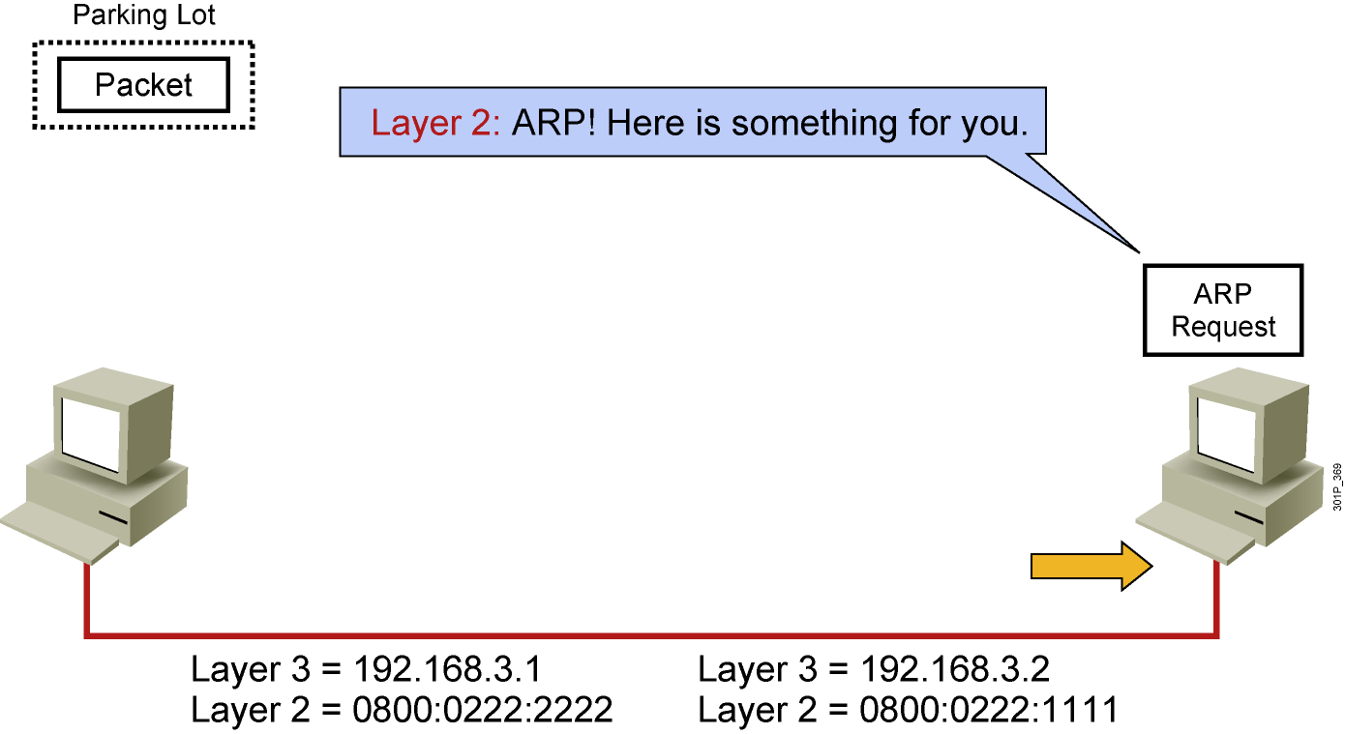
Host-to-Host Packet Delivery (7 of 22)
Notes:
Lesson Aim
<Enter lesson aim here.>

Slide 29
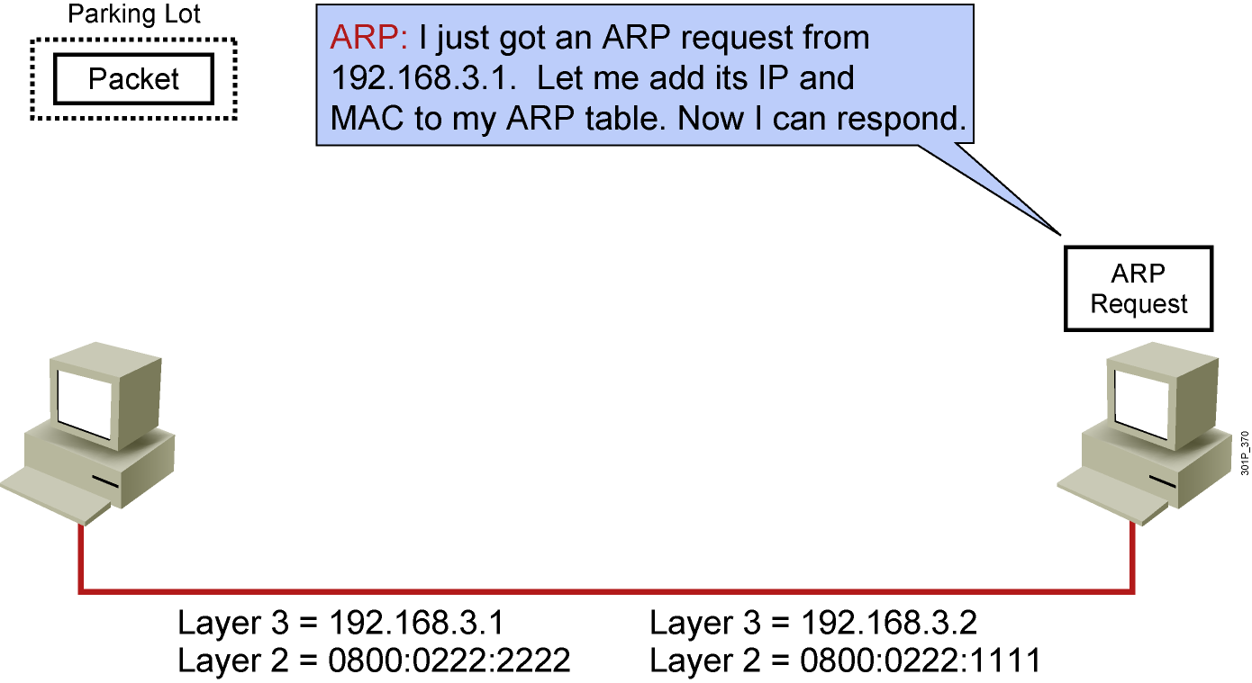
Host-to-Host Packet Delivery (8 of 22)
Notes:
Lesson Aim
<Enter lesson aim here.>

Slide 30
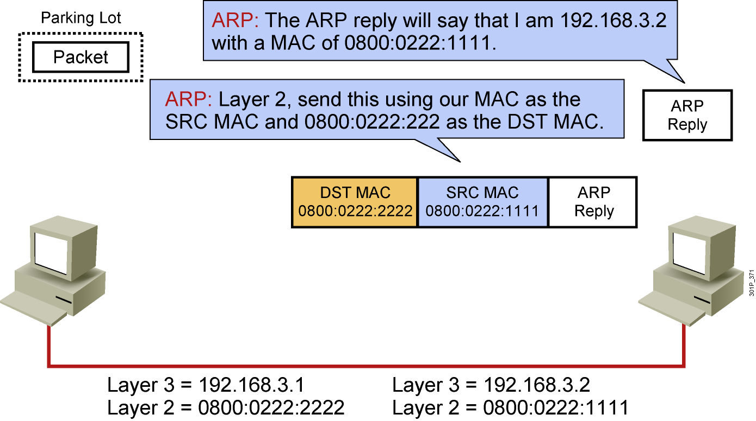
Host-to-Host Packet Delivery (9 of 22)
Notes:
Lesson Aim
<Enter lesson aim here.>

Slide 31
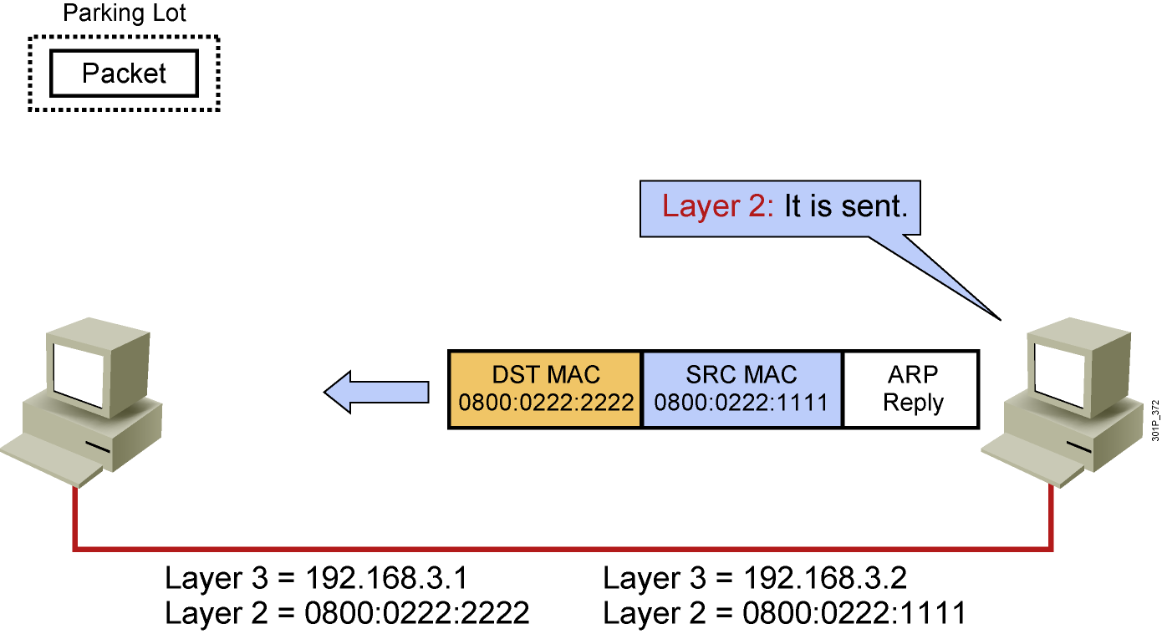
Host-to-Host Packet Delivery (10 of 22)
Notes:
Lesson Aim
<Enter lesson aim here.>

Slide 32
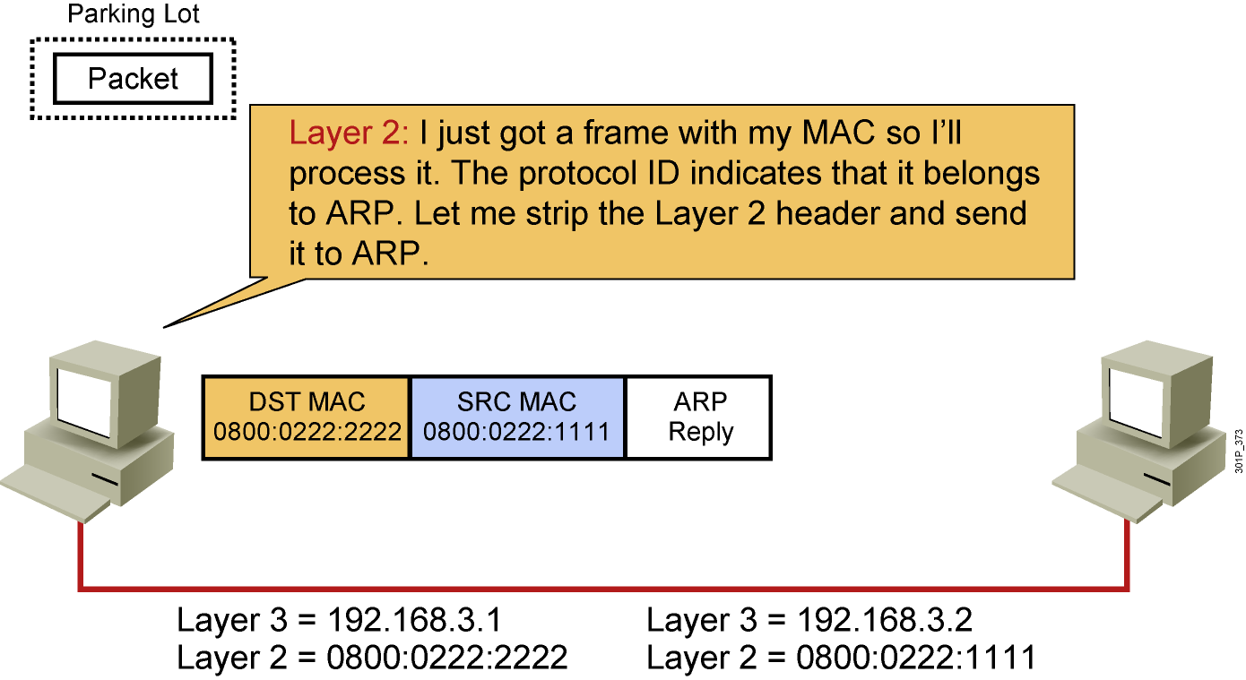
Host-to-Host Packet Delivery (11 of 22)
Notes:
Lesson Aim
<Enter lesson aim here.>

Slide 33
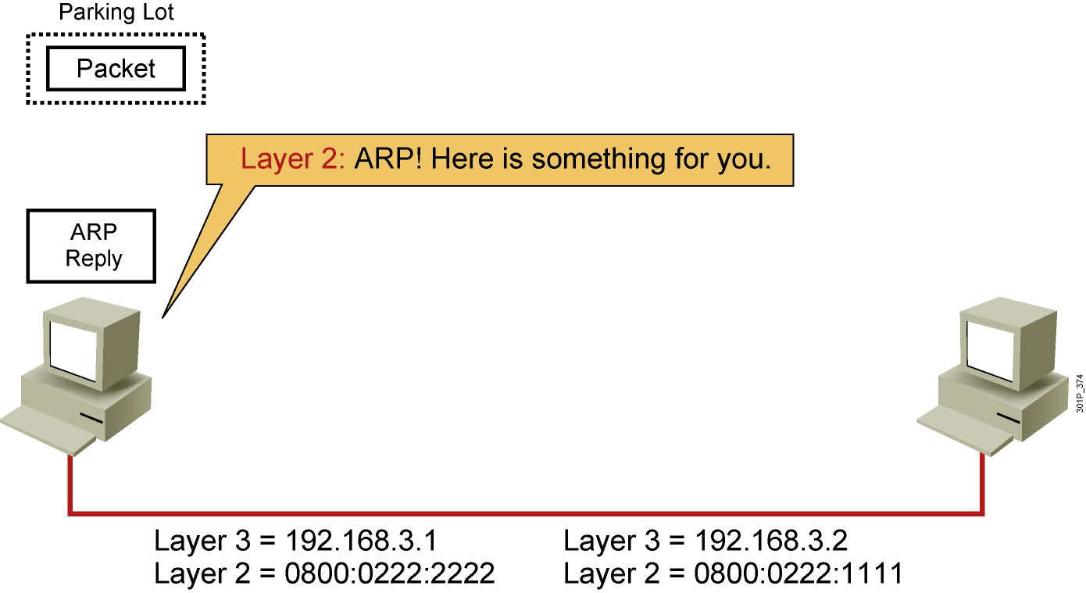
Host-to-Host Packet Delivery (12 of 22)
Notes:
Lesson Aim
<Enter lesson aim here.>

Slide 34
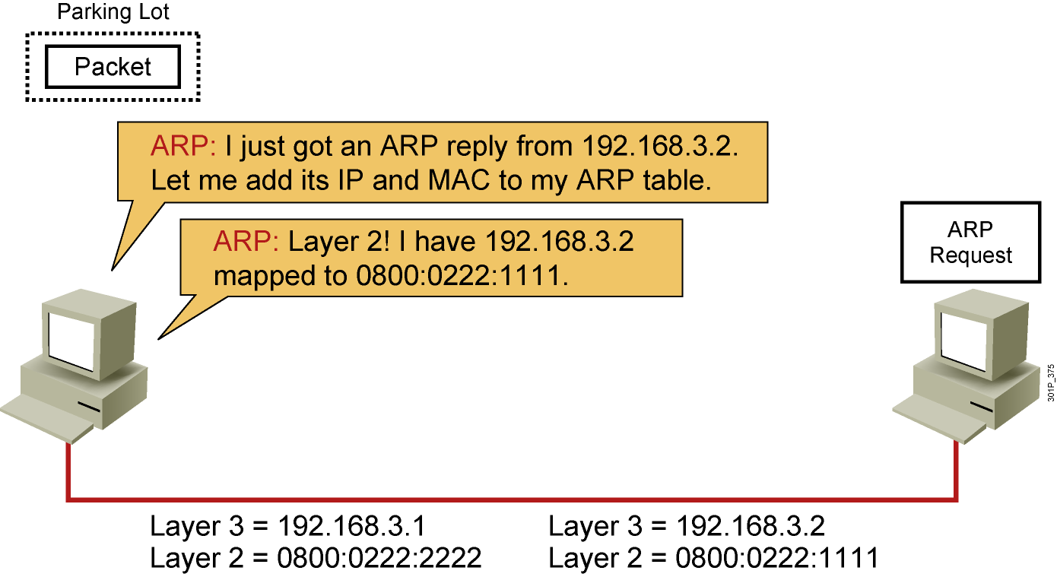
Host-to-Host Packet Delivery (13 of 22)
Notes:
Lesson Aim
<Enter lesson aim here.>

Slide 35
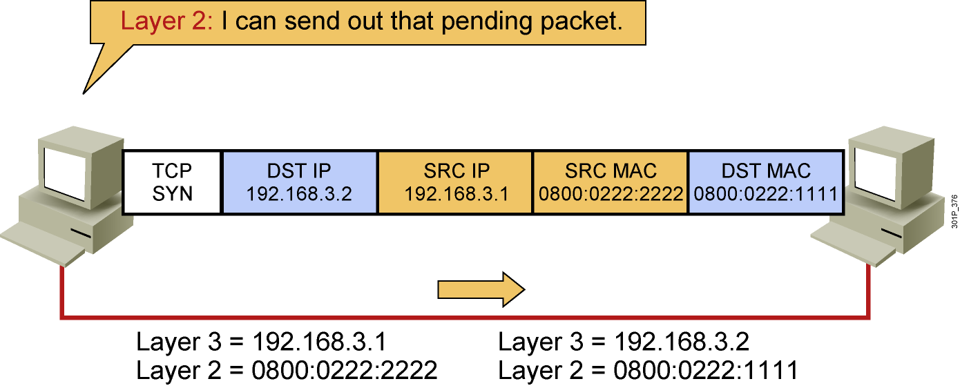
Host-to-Host Packet Delivery (14 of 22)
Notes:
Lesson Aim
<Enter lesson aim here.>

Slide 36
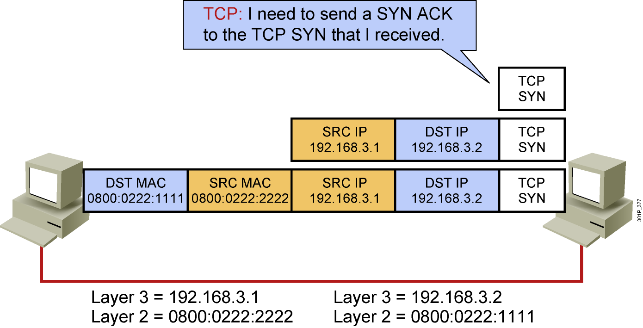
Host-to-Host Packet Delivery (15 of 22)
Notes:
Lesson Aim
<Enter lesson aim here.>

Slide 37
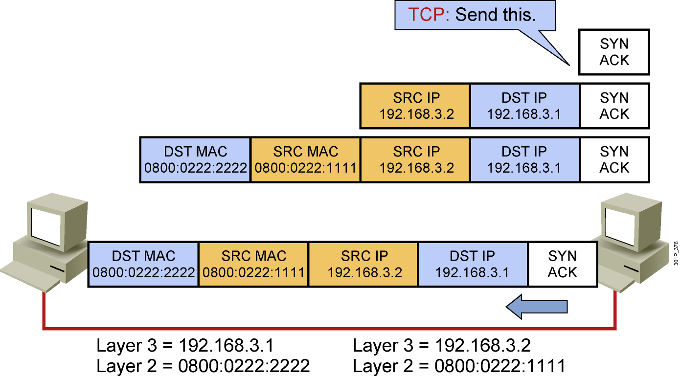
Host-to-Host Packet Delivery (16 of 22)
Notes:
Lesson Aim
<Enter lesson aim here.>

Slide 38
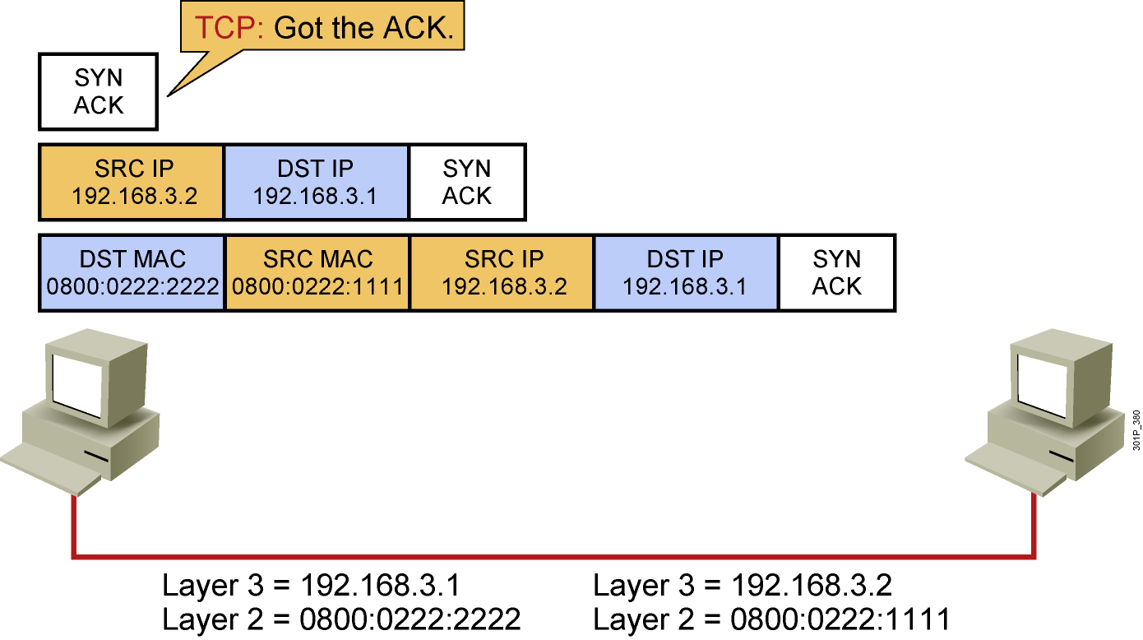
Host-to-Host Packet Delivery (17 of 22)
Notes:
Lesson Aim
<Enter lesson aim here.>

Slide 39
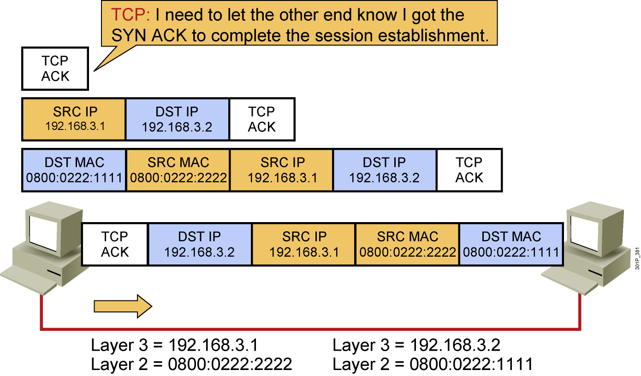
Host-to-Host Packet Delivery (18 of 22)
Notes:
Lesson Aim
<Enter lesson aim here.>

Slide 40
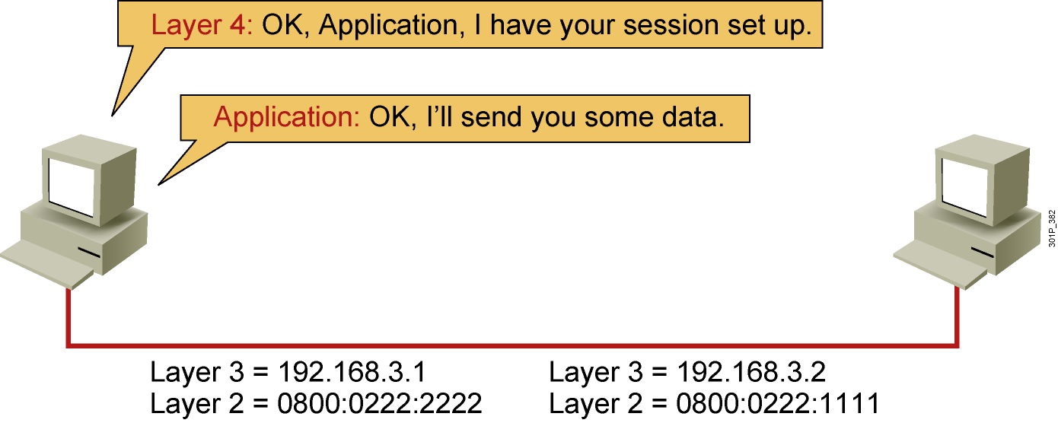
Host-to-Host Packet Delivery (19 of 22)
Notes:
Lesson Aim
<Enter lesson aim here.>

Slide 41
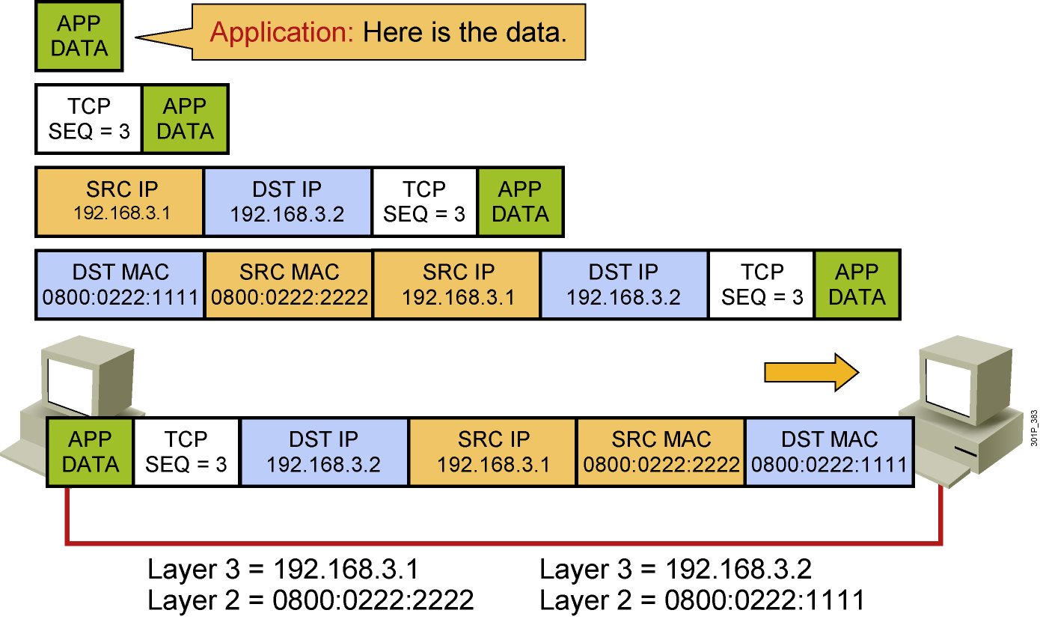
Host-to-Host Packet Delivery (20 of 22)
Notes:
Lesson Aim
<Enter lesson aim here.>

Slide 42
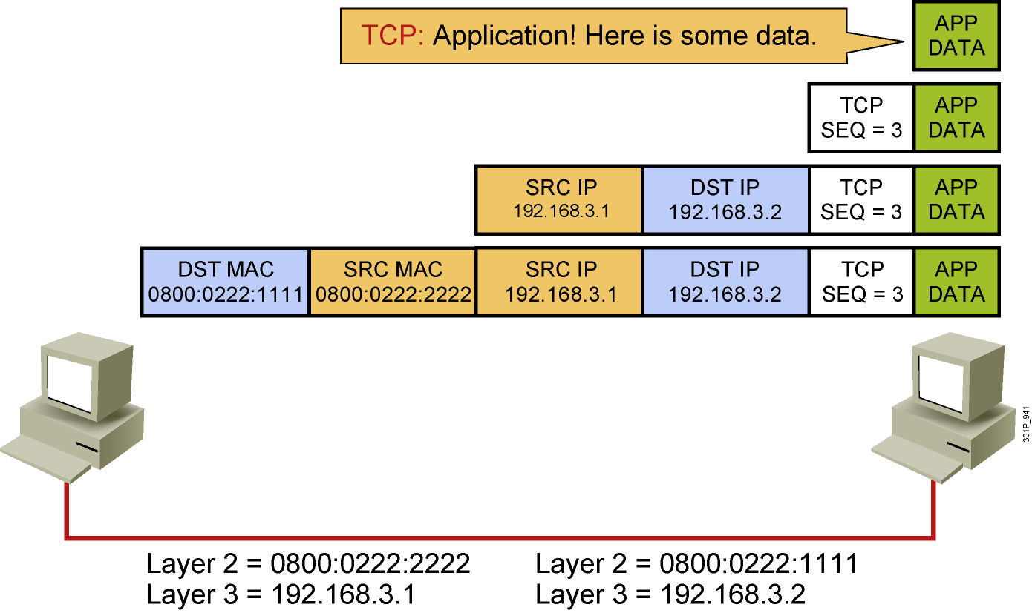
Host-to-Host Packet Delivery (21 of 22)
Notes:
Lesson Aim
<Enter lesson aim here.>

Slide 43
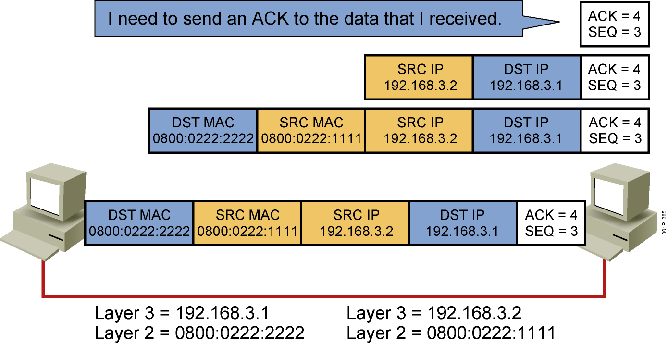
Host-to-Host Packet Delivery (22 of 22)
Notes:
Lesson Aim
<Enter lesson aim here.>

Slide 44
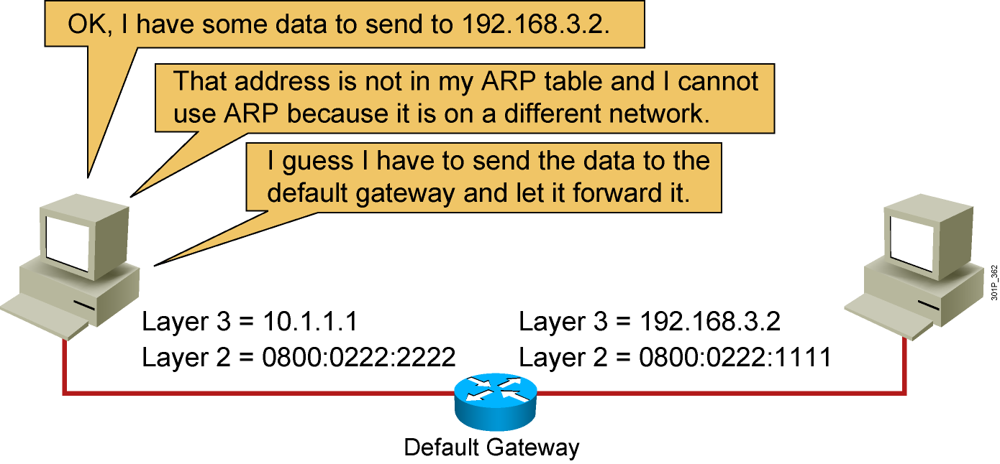
Default Gateway
Notes:
Lesson Aim
<Enter lesson aim here.>

Slide 45
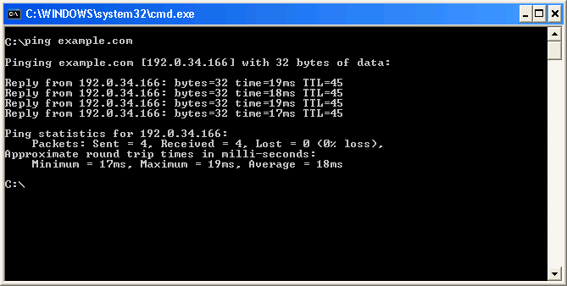
Host-Based Tools: ping

Slide 46
Host-Based Tools: Table

Slide 47
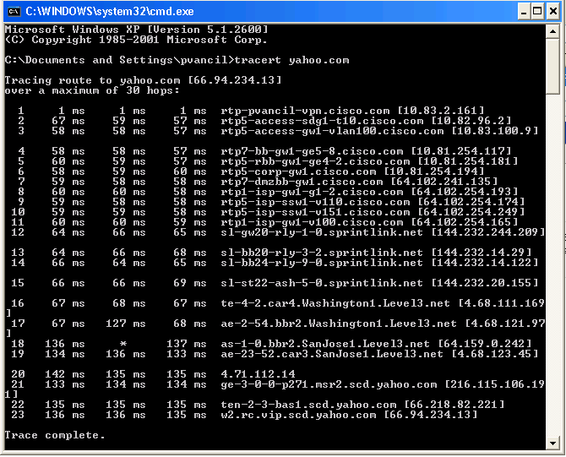
Host-Based Tools: tracert

Slide 48
III. Exploring the packet Delivery Process 2 (layer 2)

Slide 49
Layer 2 Addressing
Uses MAC address
Assigned to end devices
Notes:
Lesson Aim
<Enter lesson aim here.>

Slide 50

Layer 3 Addressing
Each NOS has its own Layer 3 address format.
OSI uses NSAP.
TCP/IP uses IP.
Notes:
Lesson Aim
<Enter lesson aim here.>

Slide 51
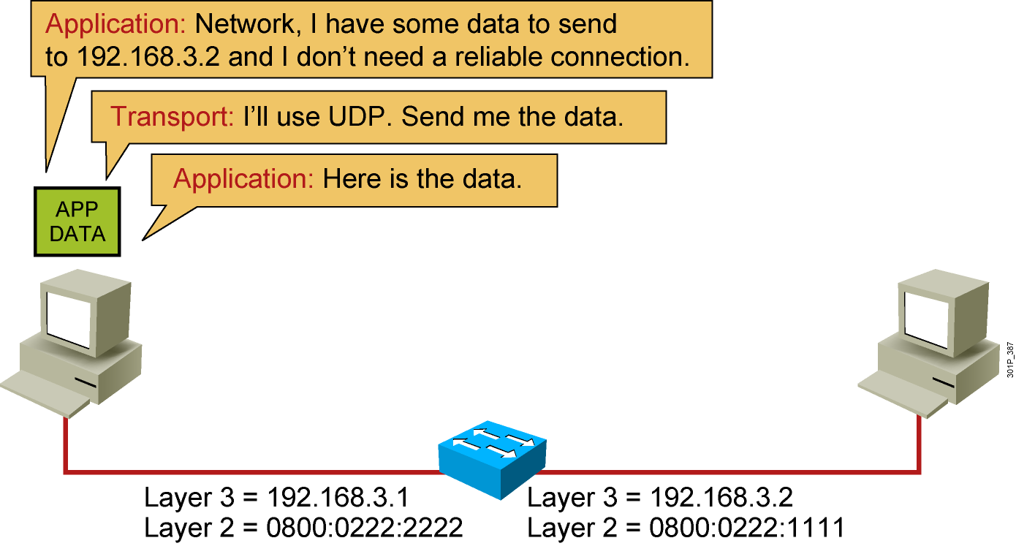
Host-to-Host Packet Delivery (1 of 10)
Notes:
Lesson Aim
<Enter lesson aim here.>

Slide 52
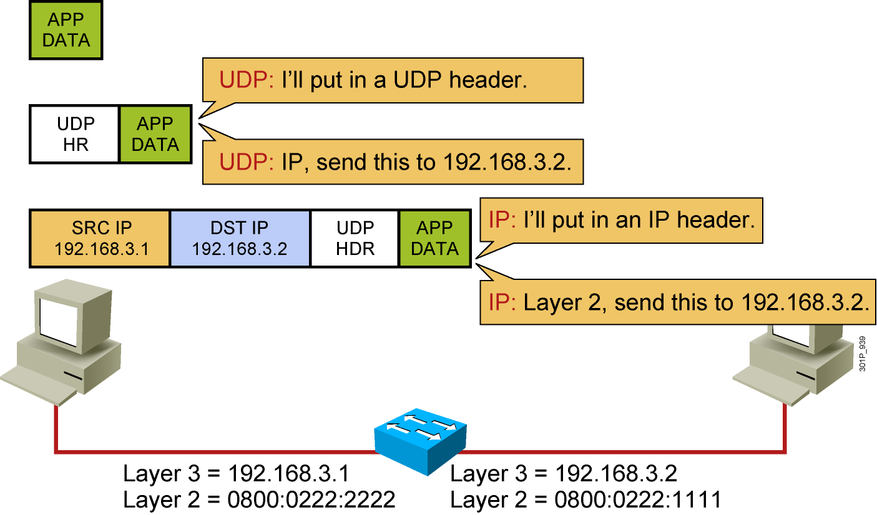
Host-to-Host Packet Delivery (2 of 10)
Notes:
Lesson Aim
<Enter lesson aim here.>

Slide 53
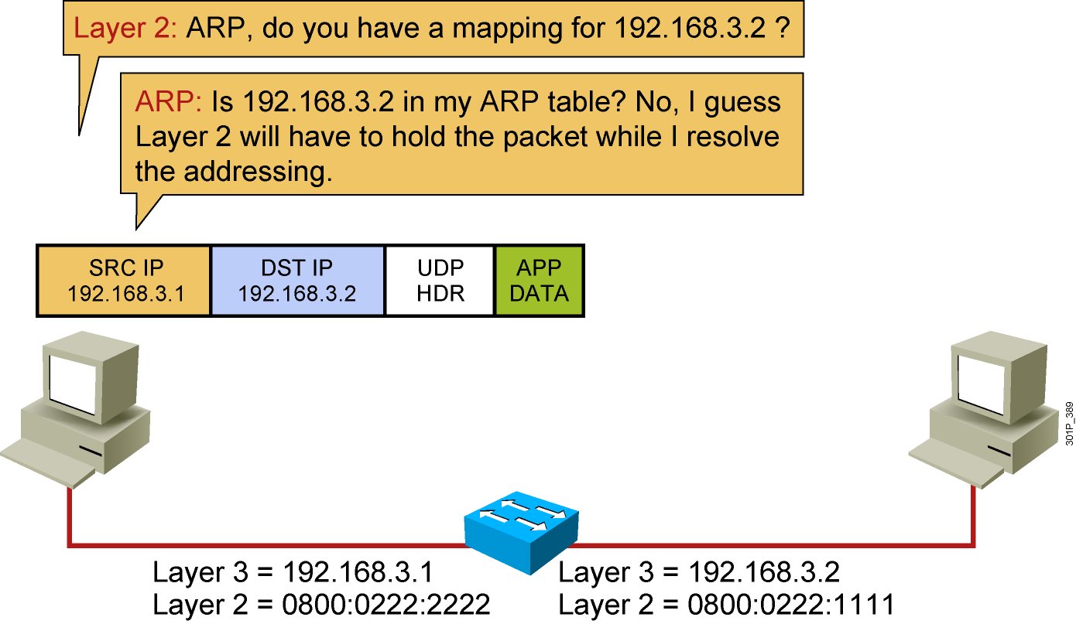
Host-to-Host Packet Delivery (3 of 10)
Notes:
Lesson Aim
<Enter lesson aim here.>

Slide 54
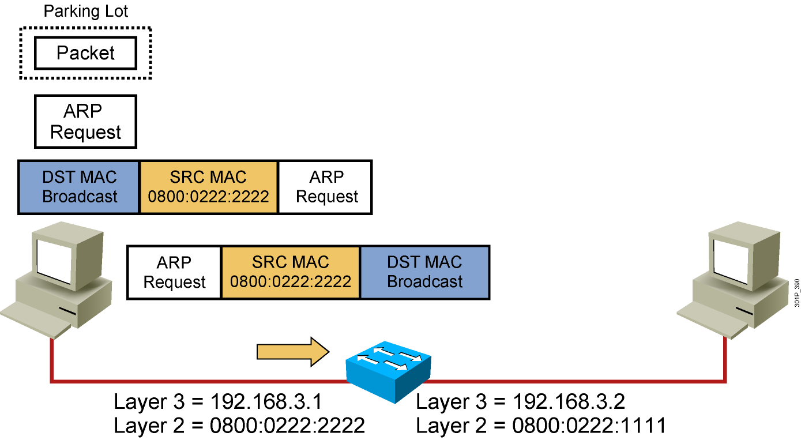
Host-to-Host Packet Delivery (4 of 10)
Notes:
Lesson Aim
<Enter lesson aim here.>

Slide 55
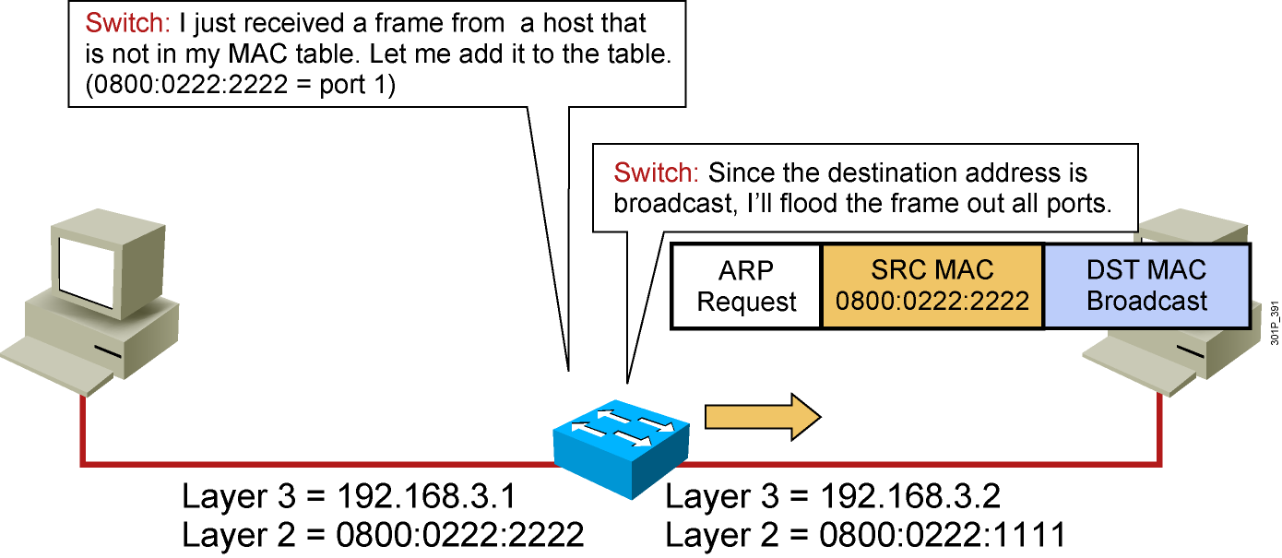
Host-to-Host Packet Delivery (5 of 10)
Notes:
Lesson Aim
<Enter lesson aim here.>

Slide 56
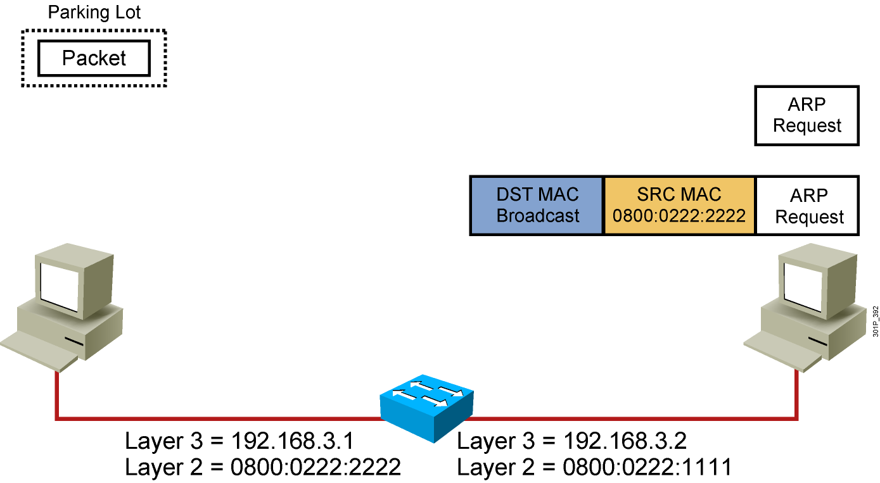
Host-to-Host Packet Delivery (6 of 10)
Notes:
Lesson Aim
<Enter lesson aim here.>

Slide 57
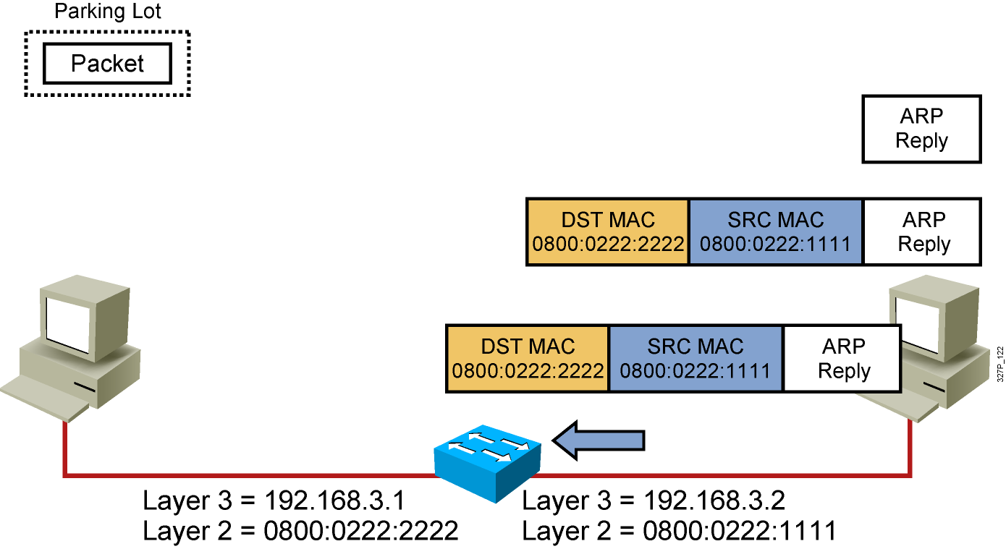
Host-to-Host Packet Delivery (7 of 10)
Notes:
Lesson Aim
<Enter lesson aim here.>

Slide 58

Host-to-Host Packet Delivery (8 of 10)
Notes:
Lesson Aim
<Enter lesson aim here.>

Slide 59

Host-to-Host Packet Delivery (9 of 10)
Notes:
Lesson Aim
<Enter lesson aim here.>

Slide 60

Host-to-Host Packet Delivery (10 of 10)
Notes:
Lesson Aim
<Enter lesson aim here.>

Slide 61
IV. Exploring the packet Delivery Process 3 (layer 3)

Slide 62

Layer 2 Addressing
Notes:
Lesson Aim
<Enter lesson aim here.>

Slide 63

Layer 3 Addressing
Notes:
Lesson Aim
<Enter lesson aim here.>

Slide 64

Host-to-Host Packet Delivery (1 of 17)
Notes:
Lesson Aim
<Enter lesson aim here.>

Slide 65

Host-to-Host Packet Delivery (2 of 17)
Notes:
Lesson Aim
<Enter lesson aim here.>

Slide 66

Host-to-Host Packet Delivery (3 of 17)
Notes:
Lesson Aim
<Enter lesson aim here.>

Slide 67

Host-to-Host Packet Delivery (4 of 17)
Notes:
Lesson Aim
<Enter lesson aim here.>

Slide 68

Host-to-Host Packet Delivery (5 of 17)
Notes:
Lesson Aim
<Enter lesson aim here.>

Slide 69

Host-to-Host Packet Delivery (6 of 17)
Notes:
Lesson Aim
<Enter lesson aim here.>

Slide 70

Host-to-Host Packet Delivery (7 of 17)
Notes:
Lesson Aim
<Enter lesson aim here.>

Slide 71

Host-to-Host Packet Delivery (8 of 17)
Notes:
Lesson Aim
<Enter lesson aim here.>

Slide 72

Host-to-Host Packet Delivery (9 of 17)
Notes:
Lesson Aim
<Enter lesson aim here.>

Slide 73

Host-to-Host Packet Delivery (10 of 17)
Notes:
Lesson Aim
<Enter lesson aim here.>

Slide 74

Host-to-Host Packet Delivery (11 of 17)
Destination | Next Hop | Interface
192.168.3.0/24 | Connected | fa 0/0
192.168.4.0/24 | Connected | fa 0/1
Notes:
Lesson Aim
<Enter lesson aim here.>

Slide 75
Host-to-Host Packet Delivery (12 of 17)
Notes:
Lesson Aim
<Enter lesson aim here.>

Slide 76

Host-to-Host Packet Delivery (13 of 17)
Notes:
Lesson Aim
<Enter lesson aim here.>

Slide 77

Host-to-Host Packet Delivery (14 of 17)
Notes:
Lesson Aim
<Enter lesson aim here.>

Slide 78

Host-to-Host Packet Delivery (15 of 17)
Notes:
Lesson Aim
<Enter lesson aim here.>

Slide 79

Host-to-Host Packet Delivery (16 of 17)
Notes:
Lesson Aim
<Enter lesson aim here.>

Slide 80

Host-to-Host Packet Delivery (17 of 17)
Notes:
Lesson Aim
<Enter lesson aim here.>

Slide 81
Exercise
2. Một thiết bị Switch có dữ liệu bảng MAC như bảng sau: Switch sẽ làm gì (Flood, Filter, Forward, Buffer) với gói tin được:
Gửi từ Client A tới Client E
Gửi từ Client A tới Client F
Gửi từ Client B tới Client G
Port | Client | MAC address
1 | A | 00-09-27-01-29-87
1 | B | 00-09-27-20-20-AE
2 | C | 00-09-27-01-10-1F
2 | D | 00-09-27-AD-01-87
1 | E | 00-09-27-BA-D1-00
2 | F | 00-09-27-AB-01-10
Notes:
There are three distinct functions of layer 2 switching: address learning, forward/filter decisions, and loop avoidance. Address learning Layer 2 switches and bridges remember the source MAC address of each frame received on an interface, and enter this information into a MAC table called a forward/filter table.
Forward/filter decisions When a frame is received on an interface, the switch looks at the destination MAC address and finds the exit interface in the MAC table. The frame is only forwarded out the specified destination port.
Loop avoidance If multiple connections between switches are created for redundancy purposes, network loops can occur. Spanning Tree Protocol (STP) is used to stop network loops while still permitting redundancy.
When a switch is first powered on, the MAC table is empty. When a frame is received on a port, the source MAC address is placed in the MAC address table, along with the port ID of the port on which it was received. If the MAC address was already in the table, its associated aging countdown timer is reset (300 seconds by default). Then the MAC address table is searched using the destination MAC address to determine which action to take.
Forward If the destination MAC address comes from another port within the switch, then the frame is sent to the identified port for transmission.
Flood If the destination MAC address is not in the MAC address table, then the frame needs to be flooded and is sent to all ports except for the port through which it arrived. This action is known as unicast flooding.
Filter If the destination MAC address comes from the same port on which it was received, (in another words, source mac address and destination mac address have the same exit port) then there is no need to forward it, and it is discarded.

Slide 82

Exercise
Notes:
Đáp án:
Source IP = 172.16.22.250/24
Destination IP= 172.16.21.7/24
Source MAC = 0000.0c12.2222
Destination MAC=0000.ad12.6666

Slide 83

Exercise
Notes:
B

Slide 84
Bài tập
Tìm hiểu Switching modes:Cut-through, Store-and-forward, Fragment-free?
Trình bày đặc điểm của Switching Fabric, Circuit Switching, Packets Switching?
Tìm hiểu về Spanning Tree Protocol?
Tìm hiểu về Vlan Trunking Protocol?

